Slide 1
🎮
Pentago AI Arena
Project Defense • Adversarial Search • OOP Game System
6×6 board
Alpha-beta AI
Tkinter GUI

Slide 2
PENTAGO AI ARENA
Project Team
1
2
3
Tawhid Hossain Tomal
Afnan Ahmed
Farhana Akter Tamanna
Team Member
Team Member
Team Member

Slide 3
How the defense will flow
01
02
Game model
Architecture
Rules, board mechanics, and state representation.
How modules separate UI, logic, AI, and persistence.
03
04
AI engine
Engineering quality
Minimax, alpha-beta pruning, move ordering, and difficulty control.
Threading, JSON storage, usability features, and demo talking points.

Slide 4
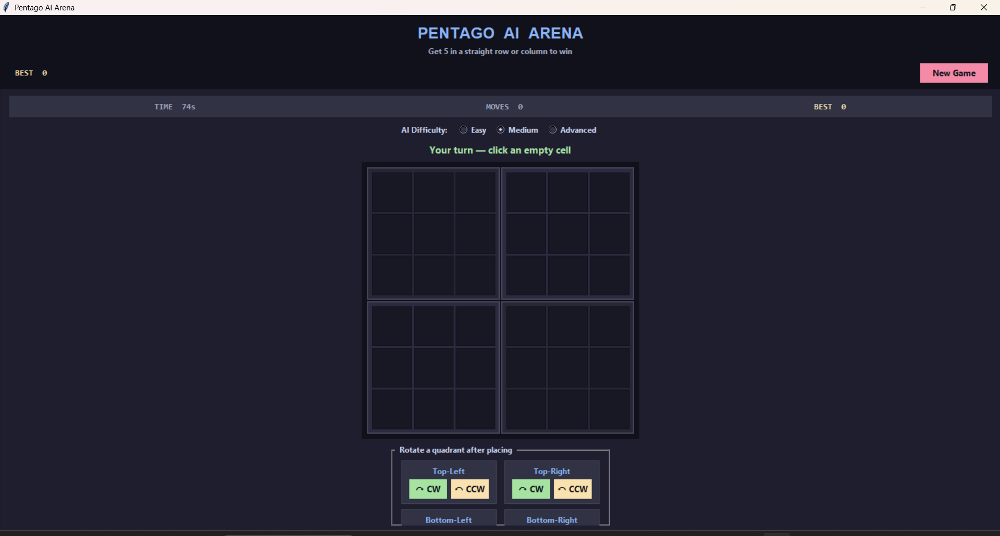
Pentago as a state-space problem
The game uses a 6×6 board split into four rotatable 3×3 quadrants.
Each turn has two actions: place one marble, then rotate one quadrant clockwise or counter-clockwise.
The configured win test checks five contiguous marbles in rows or columns, not diagonals.
This creates a large branching factor because one placement can be paired with 8 rotation choices.

Slide 5
Modular OOP design
🧩
🧠
🖥️
board.py
ai.py + evaluator.py
gui.py + score.py
PentagoBoard owns legal placement, rotation, and win-state mechanics.
Search logic and heuristic scoring stay isolated from rendering code.
Tkinter interface, background AI turn handling, timer, and persistent score tracking.
This separation improves maintainability: mechanics can be tested independently, while UI changes do not rewrite AI search logic.

Slide 6
Minimax search with alpha-beta pruning
Decision logic
Core pruning idea
Max node: AI chooses the move with the highest evaluation score.
if maximizing:
best = -∞
for move in ordered_moves:
value = search(child, depth-1, alpha, beta, False)
alpha = max(alpha, value)
if alpha ≥ beta: break
Min node: Human is modeled as an optimal opponent minimizing AI advantage.
Terminal test: Immediate wins return a very large positive or negative score.
Pruning removes branches that cannot improve the final choice.
Depth limit: Non-terminal boards are estimated by the heuristic evaluator.

Slide 7
How non-terminal boards are scored
Window-based patterns
Positional bias
AI 4
+500
AI 3
+50
AI 2
+5
Human 3
-50
Human 4
-500
Center cells of each quadrant receive a small bonus.
This encourages stable control over strategically active areas.
The bonus is lightweight, so pattern completion remains the dominant signal.
The heuristic stays zero-sum: AI rewards mirror human penalties.
All 5-cell windows across rows and columns are scanned. Mixed windows containing both players are ignored because they are blocked.

Slide 8
Move ordering and branching-factor control
Candidate prioritization
Why it matters
High local activity
90%
Better move order means earlier alpha-beta cutoffs.
Advanced mode also caps explored cells at deeper levels to keep response time practical.
This is an example of algorithm engineering: same theory, faster execution.
Medium local activity
60%
Low local activity
30%
cell_activity() ranks empty cells by nearby piece density, so tactical zones are searched first.

Slide 9
Balancing skill and playability
1
2
3
Easy
Medium
Advanced
Depth 1 lookahead and a 40% chance to play a random move, making behavior less predictable and more forgiving.
Depth 2 search chooses the best minimax branch without randomization.
Depth 3 with move ordering and cell caps produces stronger tactical play while keeping latency manageable.

Slide 10
Rotations and fast pattern detection
Sub-board rotation
Convolution-based win test
Quadrant index maps to a 3×3 slice using row and column offsets, then numpy.rot90 rotates that sub-matrix clockwise or counter-clockwise.
The evaluator converts a player mask to binary and uses a ones-kernel of length 5. A convolution value of at least 5 means five contiguous marbles.
r0 = (quadrant // 2) × 3
c0 = (quadrant % 2) × 3
sub = board[r0:r0+3, c0:c0+3]
mask = (board == player).astype(int)
kernel = np.ones(5, dtype=int)
np.convolve(line, kernel, 'valid')

Slide 11
Responsiveness and persistence
🧵
💾
Threaded AI turns
Persistent scores
The GUI starts AI computation on a daemon thread, then safely returns the chosen move to the Tkinter main loop with root.after(). This prevents the window from freezing during deeper search.
ScoreManager stores high-score data in JSON and wraps file operations with fallback error handling, so session data can survive across runs.
These two features are good defense points because they show attention to user experience, not only algorithm correctness.

Slide 12
Conclusion
•
Developed a complete Pentago game with a modular object-oriented design.
•
Implemented an AI opponent using minimax search and alpha-beta pruning.
•
Improved practical performance through move ordering and limited search depth.
•
Added difficulty levels to balance AI strength and player enjoyment.
•
Integrated a responsive GUI, threaded AI turns, and persistent score storage.
Pentago AI Arena connects AI algorithms, software architecture, and GUI design in one playable system.

Slide 13
🚀
Thank You
Ready for questions on algorithm design, architecture, and implementation choices.

